Slide 1
Surrey Youth League Pilot
Individual Survey Feedback

Slide 2
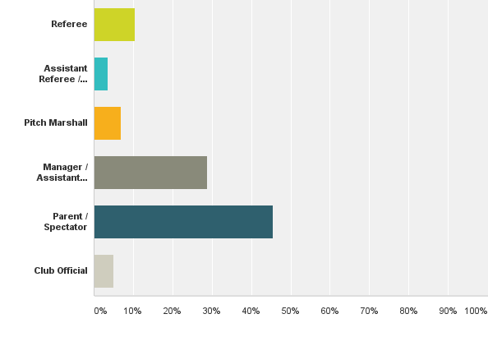
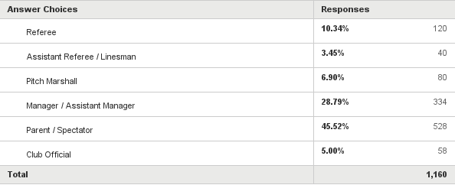
Q2: Please indicate the role you are associated with the Surrey Youth League
Answered: 1,160 Skipped: 0

Slide 3
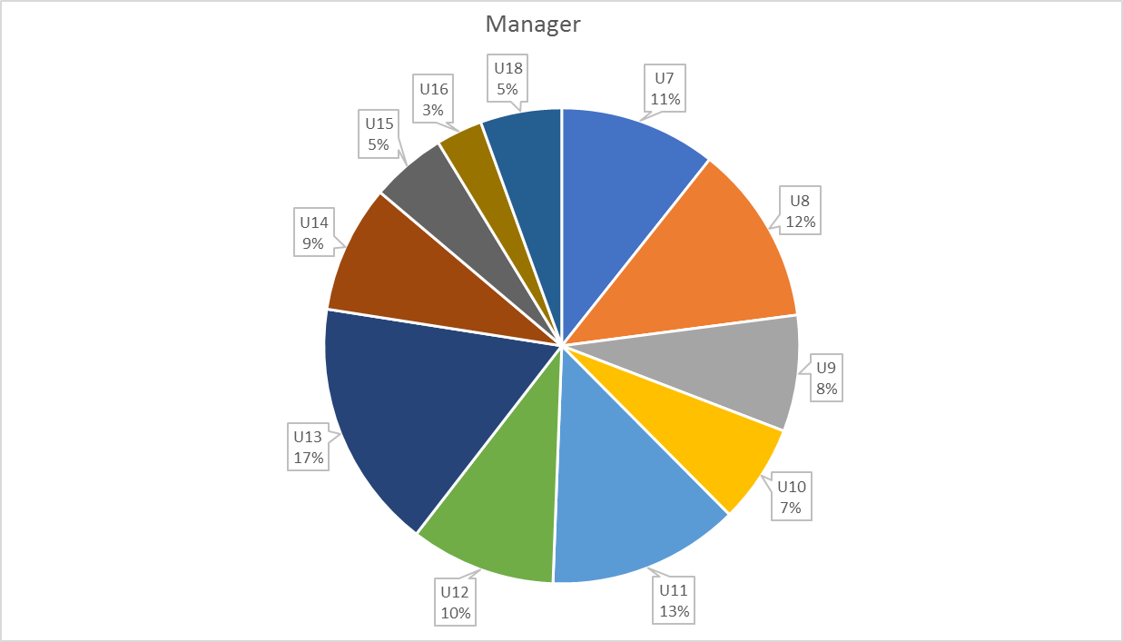
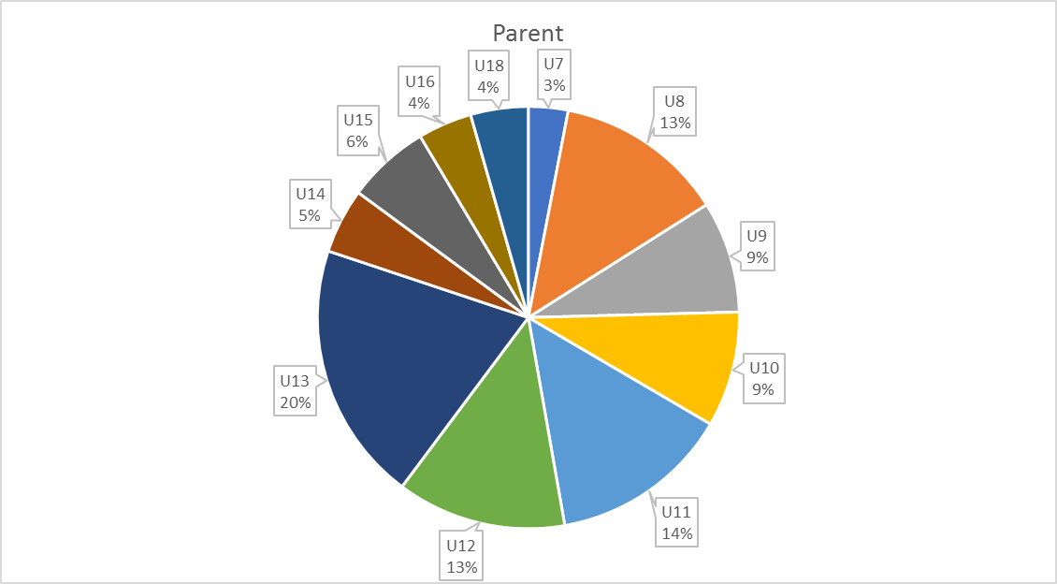
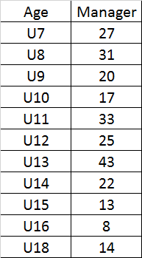
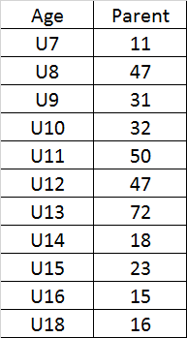
Age Group Participation

Slide 4
Question Groupings

Slide 5
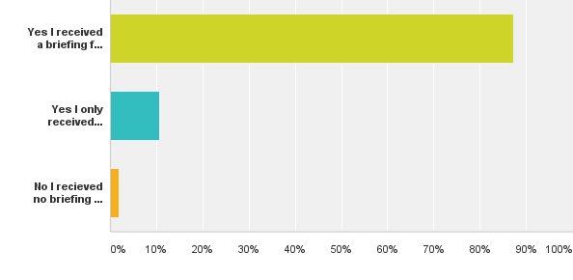
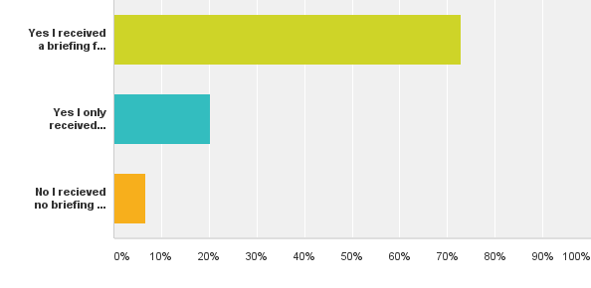
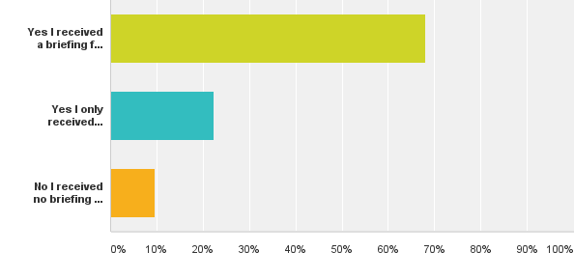
Q23: Did you receive sufficient briefing at the start of regarding the SYL Respect
Answered: Pitch Marshal
Answered: Managers
Answered: Parents
Answered: Referees

Slide 6
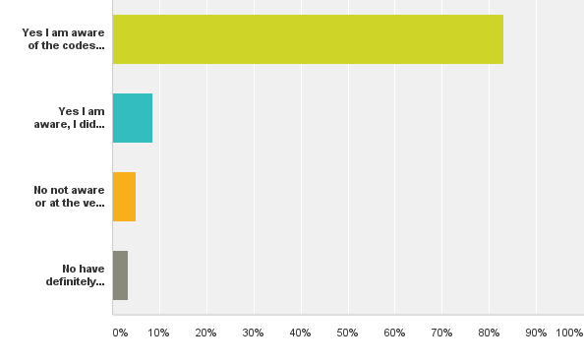
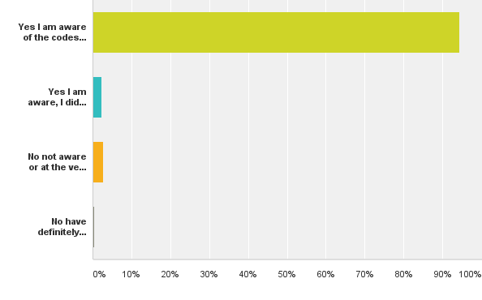
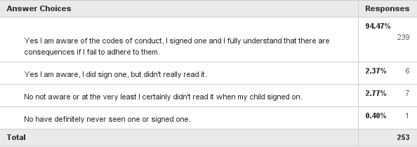
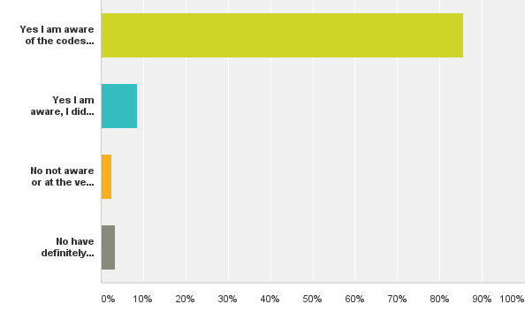
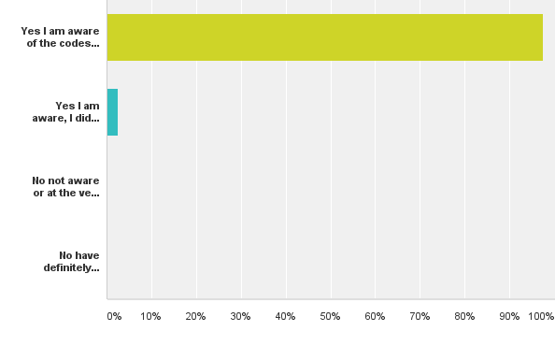
Q22: Codes of Conduct - As someone associated with a Club are you aware of the codes of conducted adopted
Answered: Pitch Marshalls
Answered: Managers
Answered: Parents
Answered: Club Officials

Slide 7
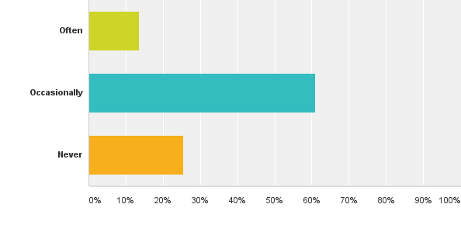
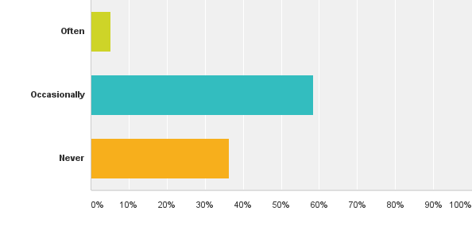
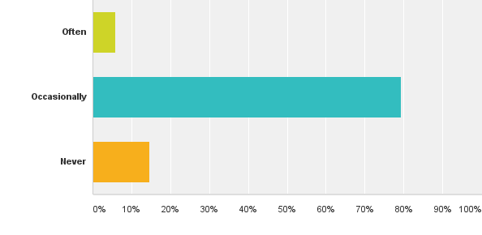
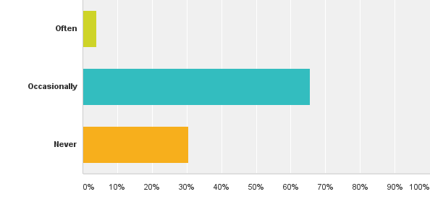
Q31: Do you see people disrespecting Referees?
Answered: Pitch Marshall
Answered: Parents
Answered: Linesman
Answered: Manager

Slide 8
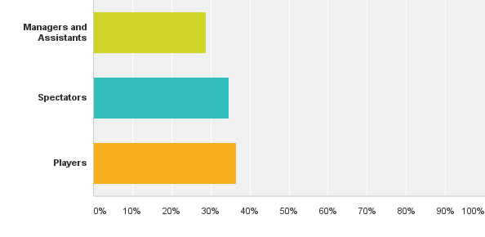
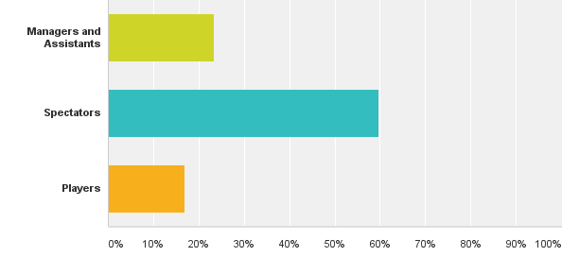
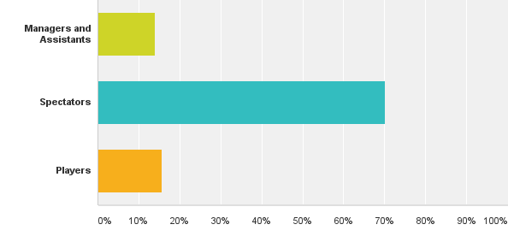
Q16: If you observe disrespect shown towards a referee where does it mainly come from?
Answered: 101 Referee
Answered: 253 Managers
Answered: 363 Parents and Spectators

Slide 9
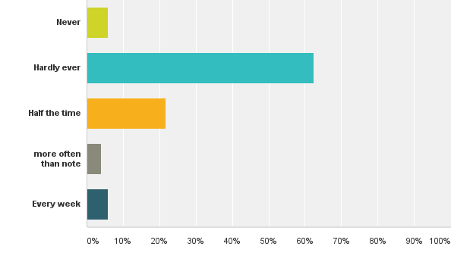
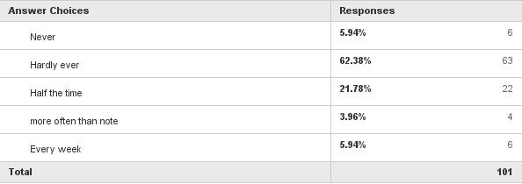
Q14: Respect Levels - What level of disrespect do you encounter weekly?
Answered: 101 Referee

Slide 10
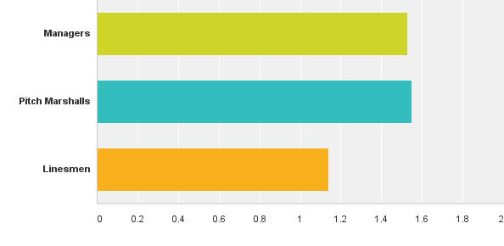
What percentage of Referees hold briefings with you?
Referees Do you hold pre match briefings with
Answered: Managers
Answered: Pitch Marshalls
Answered: Linesman

Slide 11
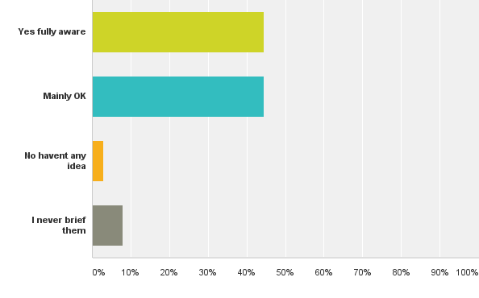
Q10: When you hold briefings with Pitch Marshalls are they aware of their roles in assisting you?
Answered: 101 Referee

Slide 12
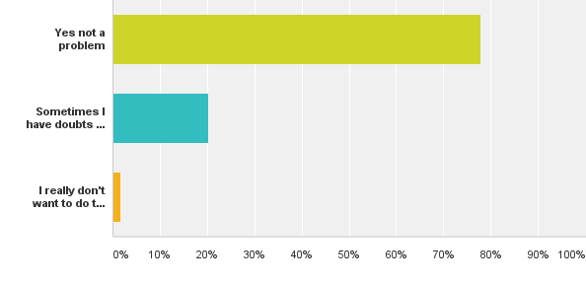
Q25: As a Pitch Marshall do you feel safe acting as a Pitch Marshall?
Q26: How do you feel about continuing to be a Pitch Marshall?

Slide 13
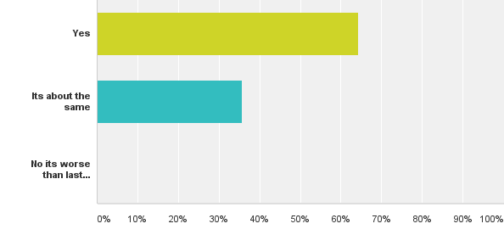
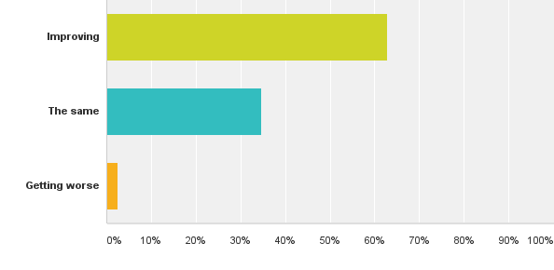
Q15: Respect Levels - Compared to last season is there an improvement
Answered: 101 Referees
Answered: 363 Parents

Slide 14
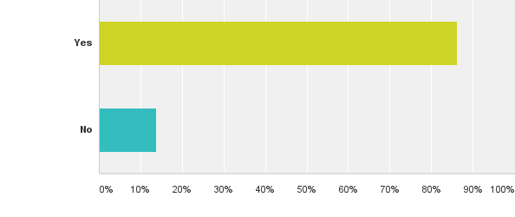
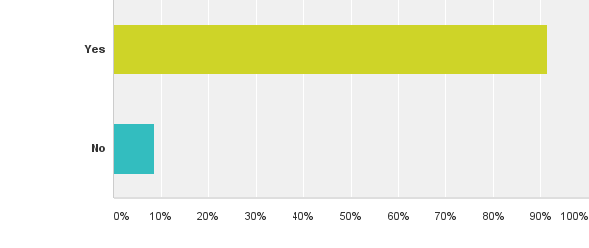
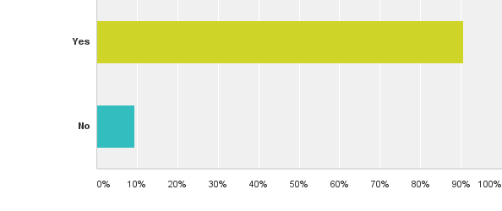
Q11: The League has given out good practice guidance for Clubs to ensure that their spectators do not stand behind the opposition Linesman. Are you aware of this guidance?
Answered: 101 Referee
Answered: 59 Pitch Marshall
Answered: 34 Linesman
Answered: 253 Managers

Slide 15
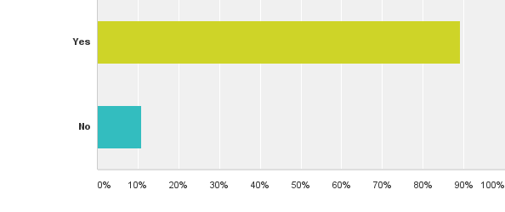
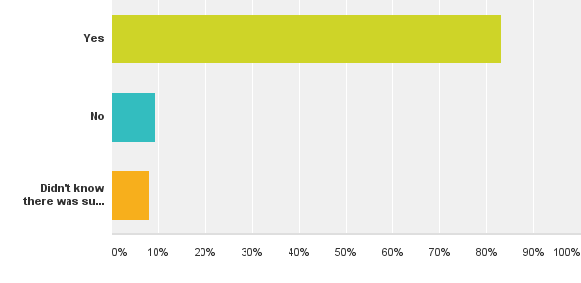
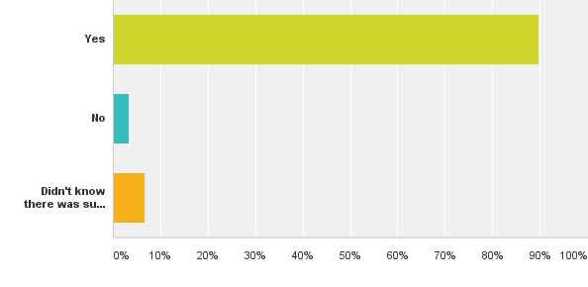
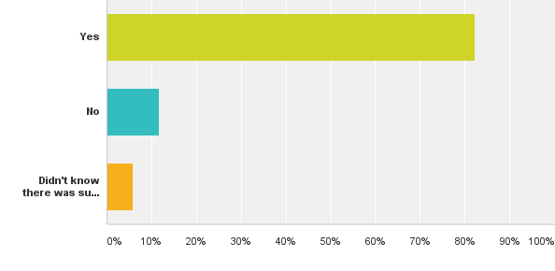
Q13: When No standing behind the Opposition Linesman is adopted do you believe it helps in reducing conflict on the touchline?
Answered: Referee
Answered: Manager
Answered: Pitch Marshall
Answered: Linesman
Answered: Parents

Slide 16
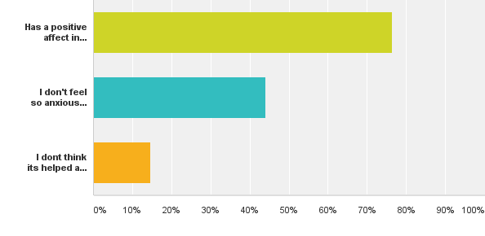
Q55: Linesman - As someone who runs the line do you feel the Good Practice Guidance on removing opposition spectators from behind you when implemented

Slide 17
Summary

Slide 18
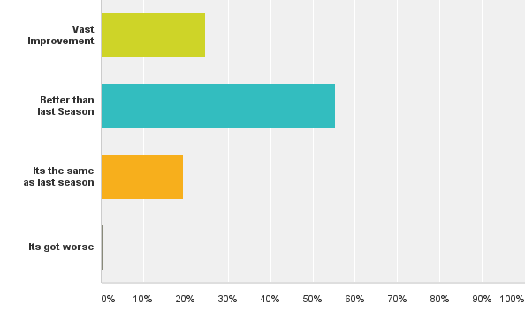
Q77: On Balance do you think the publicity of the Pilot including Match Day Signs (A Boards), visible Pitch Marshall's, awareness briefing and roped off area's, have contributed to improving the behaviours at Surrey Youth League football matches.
Answered: 796

Slide 19
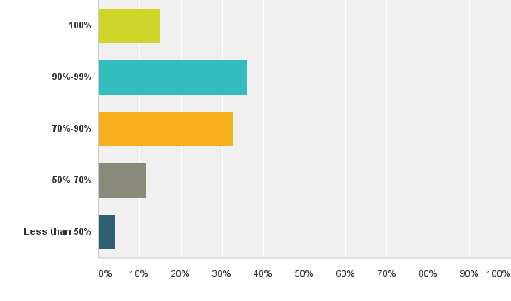
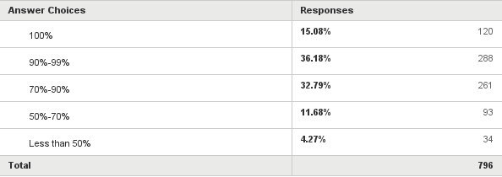
Q78: From your experience do you think all clubs are joining in the pilot
Answered: 796

Slide 20
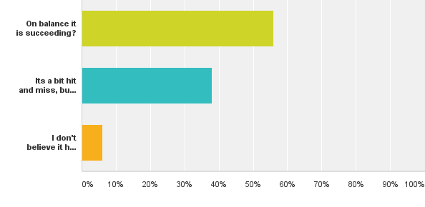
Q79: Do you believe that the Pilot is succeeding in its aims to improve touchline behaviour?

Slide 21
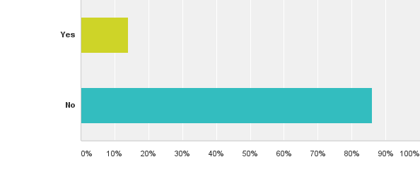
Q80: Have you seen situations where respect procedures have prevented a game degrading to something worse?

Slide 22
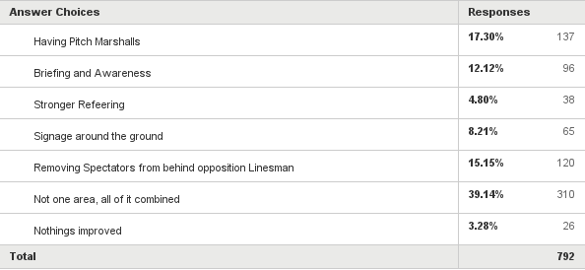
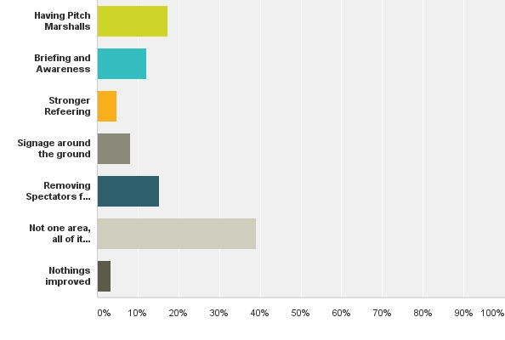
Q81: What area has contributed the most to improving behaviours

Slide 23
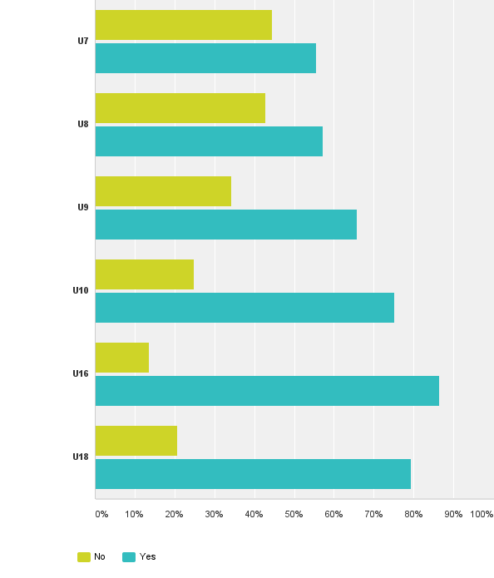
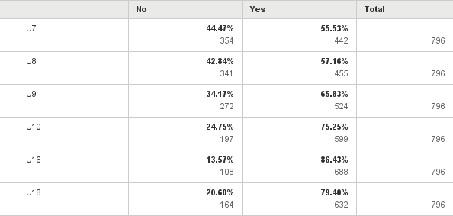
Q83: Currently the Pitch Marshall's are only compulsory at U11 to U15 age groups. Should the Pitch Marshall's be made compulsory at :-

Slide 24
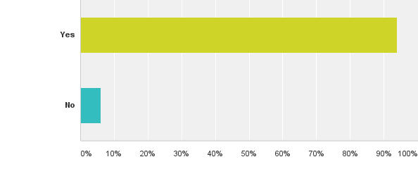
Q82: Would you support the Pilots continuation in its current form next season?

